Slide 1


1ST DATA INNOVATORS CHALLENGE
ANALYSIS AND FINDINGS
a
Team Name: Data Hunters
Team members:
Sarkar Tuhassinul Arnob
MD Shahjada Sajid
Date: 22/10/2024

Slide 2


Introduction
Objective
Analyze customer behavior to identify factors influencing customer loyalty, satisfaction, and purchase trends and Answering Questions.
Key Goals:
Identify factors contributing to customer loyalty.
Analyze how payment methods affect satisfaction and return rates.
Examine the relationship between customer location, purchase amount, and delivery time.
Provide actionable insights to boost retention and satisfaction

Slide 3


Data Overview
Entries: The dataset contains 10000 entries representing individual customer records.
Features: There are 16 columns or features in the dataset, each representing different aspects of customer behavior and transactions.

Slide 4


Data Cleaning Process
Step 1: Handling Missing Values
Step 2: Removing Duplicates
Step 3: Data Type Conversions
Final Dataset is the given Dataset.

Slide 5

Analysis and Insights
Level 1: Basic Insights
Q1: Find Mean, Median, and Mode (Age)
Q2: Find variance, standard deviation, and z-score (Purchase Amount)
Q3: What are the top three product categories based on the number of purchases?
Q4: How many customers are classified as return customers?
Q5: What is the average review score given by customers?
Q6: How does the average delivery time vary between subscription statuses (Free, Premium)?
Q7: How many customers are subscribed to the service?
Q8: What percentage of customers used devices to make purchases? (Mobile, Desktop, Tablet)
Q9: What is the average purchase amount for customers who availed discounts compared to those who didn’t?
Q10: What is the most common payment method used by customers?

Slide 6

Level 1
Q1: Find Mean, Median, and Mode (Age)
Mean: 43.7899
Median: 44.0
Mode: 51

Slide 7
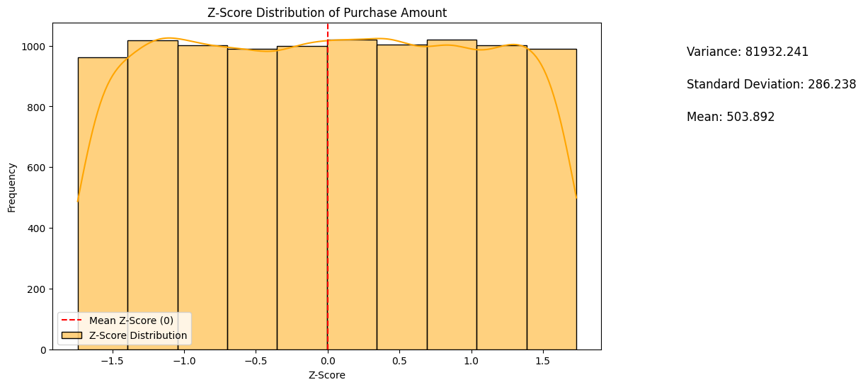
Level 1
Q2: Find Variance, Standard Deviation, and Z-Score (Purchase Amount)
Variance : 81932.241
Standard Deviation : 286.238
Minimum Z-Score: -1.724
Maximum Z-Score: 1.733

Slide 8

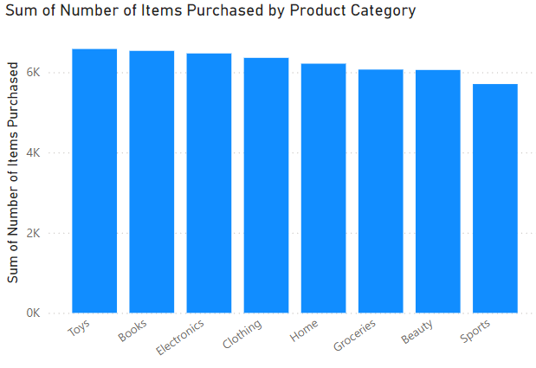
Level 1
Q3: Top Three Product Categories Based on Purchases
Top Three Products:
Toys
Books
Electronics

Slide 9

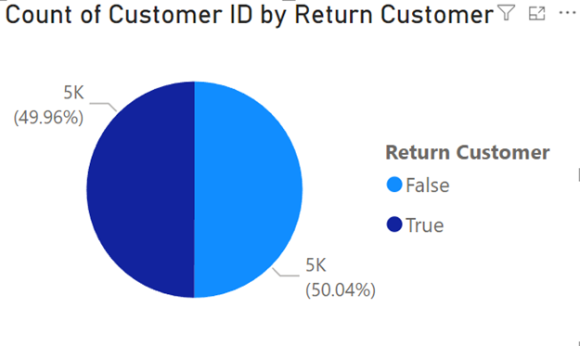
Level 1
Q4: Number of Return Customers
Total Return Customers: 4996
Total Non Return Customers: 5004
Q5: Average Review Score Given by Customers
Average Review Score: 3.0

Slide 10
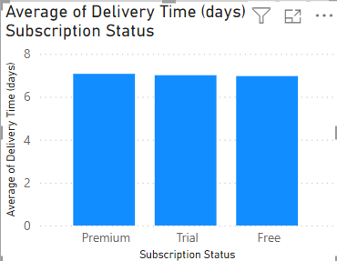
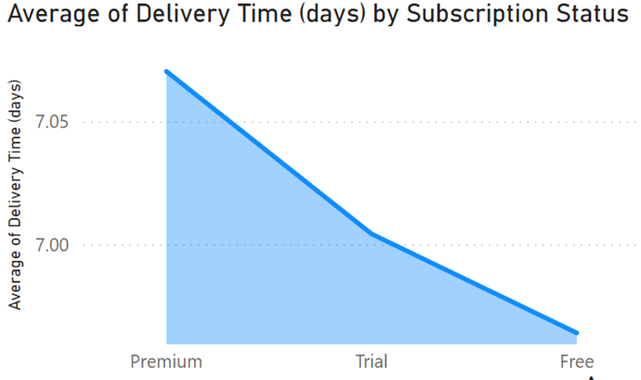
Level 1
Q6: Average Delivery Time (Free vs. Premium Subscription)
Q7: Total Number of Subscribed Customers
Subscribed Customers: 3369

Slide 11

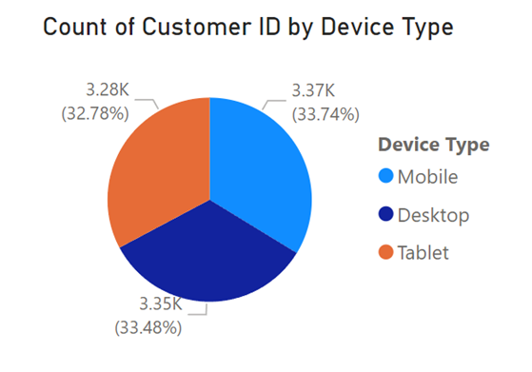
Level 1
Q8: Percentage of Customers Using Devices (Mobile, Desktop, Tablet)
Mobile: 33.74 %
Desktop: 33.48 %
Tablet: 32.78 %

Slide 12

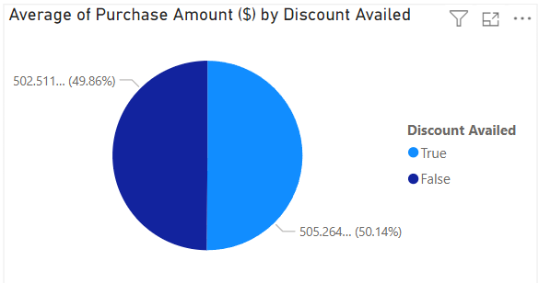
Level 1
Q9: Average Purchase Amount (Discounted vs. Non-Discounted)

Slide 13
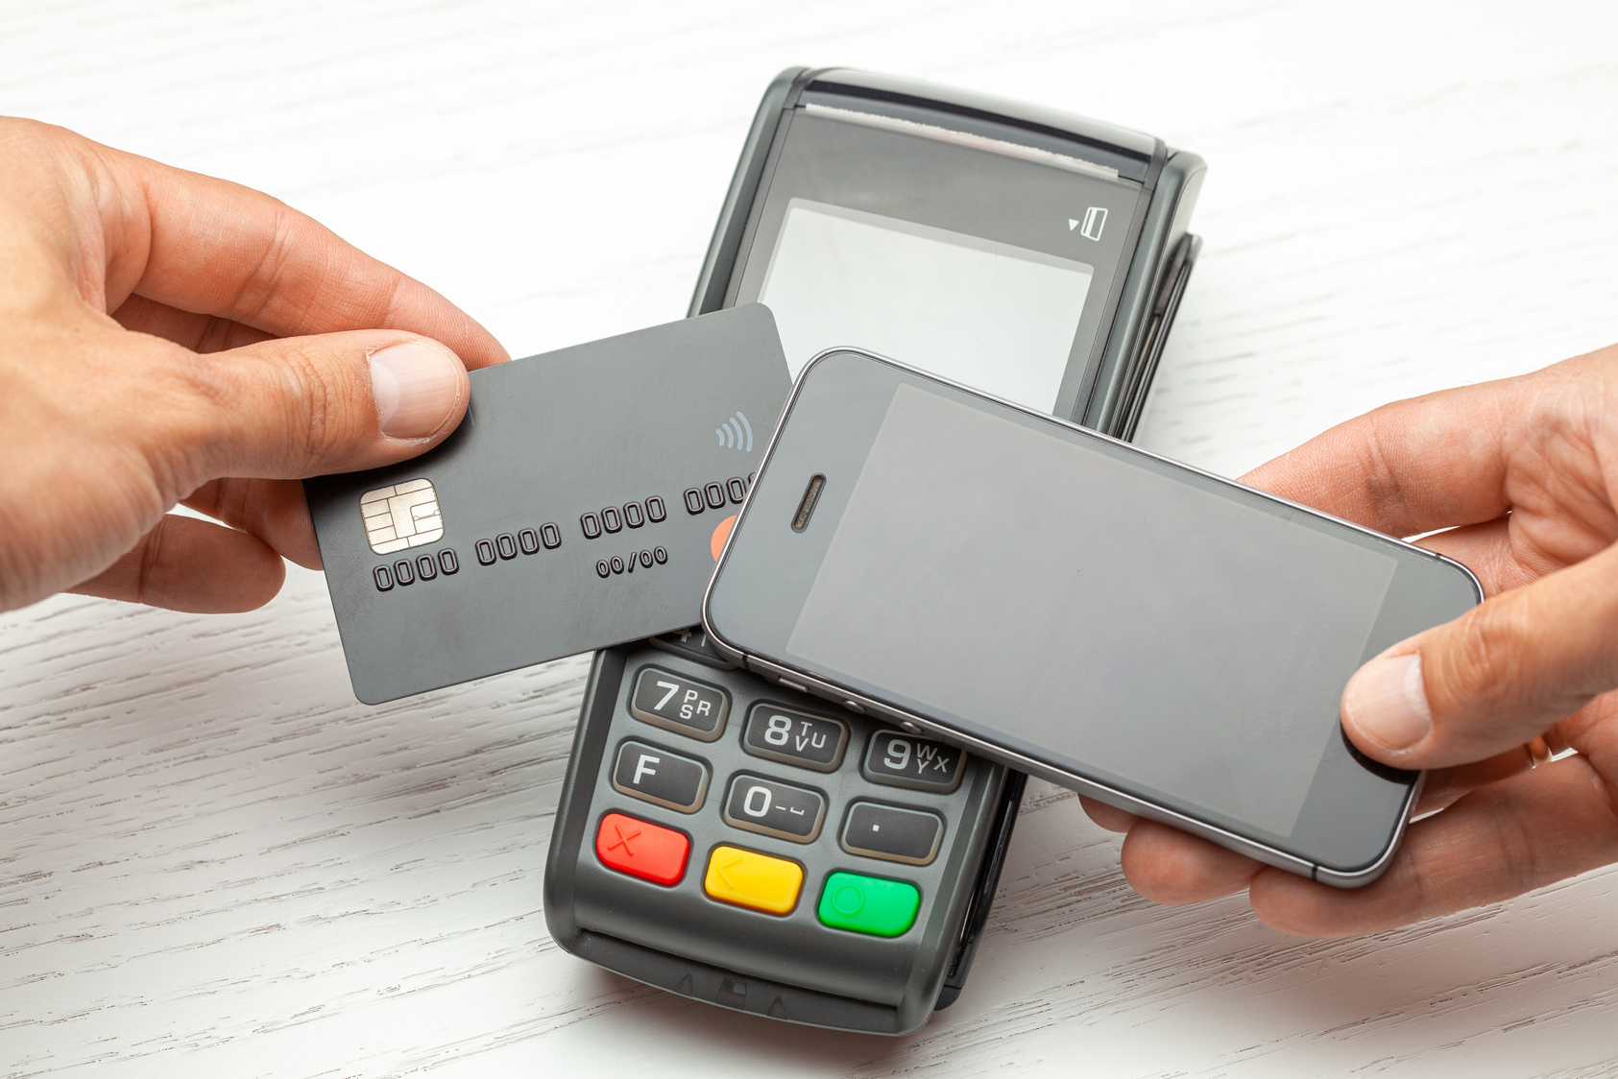
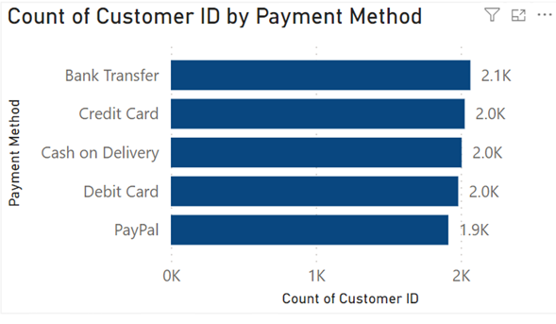
Level 1
Q10: Most Common Payment Method
Most Common Payment Method:
Bank Transfer

Slide 14
Analysis and Insights
Level 2: Intermediate Insights
Q1: What are the average review scores of users of the most common payment method?
Q2: What is the correlation between time spent on the website and purchase amount? Do customers who spend more time on the website purchase more items?
Q3: What percentage of customers are satisfied (rating of 4 or 5) and are also return customers?
Q4: What is the relationship between the number of items purchased and customer satisfaction?
Q5: Which location has the 2nd highest average purchase amount?

Slide 15

Level 2
Q1: Average Review Scores of Users of the Most Common Payment Method
Payment Method: Bank Transfer
Average Review Score: 3.0
Q2: What is the correlation between time spent on the website and purchase amount? Do customers who spend more time on the website purchase more items?
Correlation Coefficient: 0.010025

Slide 16

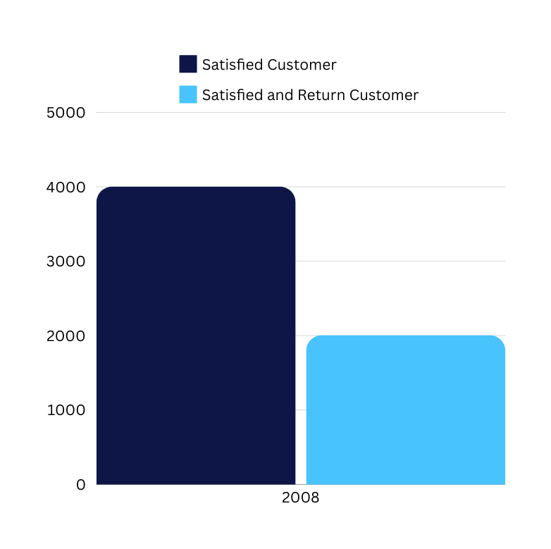
Level 2
Q3: Percentage of Satisfied (Rating 4 or 5) and Return Customers
Percentage of Satisfied Return Customers: 50.15%

Slide 17

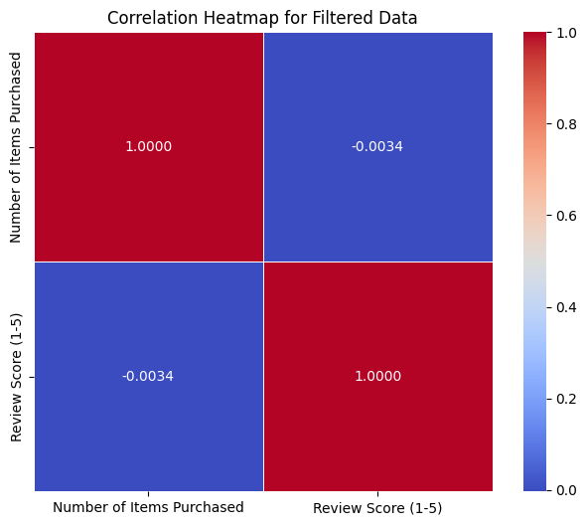
Level 2
Q4: What is the relationship between the number of items purchased and customer satisfaction?

Slide 18

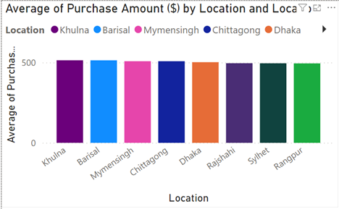
Level 2
Q5: Location with the 2nd Highest Average Purchase Amount
Location: Barisal
Average Purchase: $513.67

Slide 19
Analysis and Insights
Level 3: Critical Thinking Insights
Q1: What factors contribute most to a customer being classified as a return customer?
Q2: How do payment methods influence customer satisfaction and return rates?
Q3: How does the location influence both purchase amount and delivery time?
Q4: What major insights are found? Give a proper explanation.

Slide 20
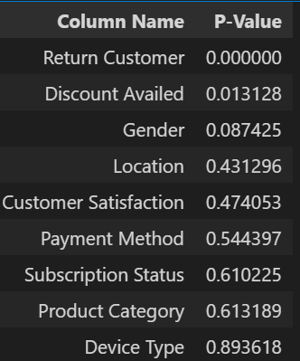
Level 3
Q1: What factors contribute most to a customer being classified as a return customer?
We used P-values and correlation analysis to identify factors contributing to return customers.
Significant Factors (P-Values):
Discount Availed: Significant (P = 0.013), indicating customers using discounts are more likely to return.
Gender: Moderate but not statistically significant (P = 0.087).
Delivery Time, Review Score, Time on Website, Purchase Amount: No significant impact.

Slide 21
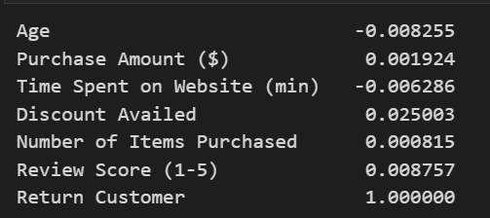
Level 3
Correlation Insights
Discount Availed: Highest positive correlation (0.025), slightly increasing return likelihood.
Other Factors: Age, purchase amount, time on the website, and items purchased showed a negligible effect.
Conclusion: Discounts are the most influential factor driving return customer behavior.

Slide 22
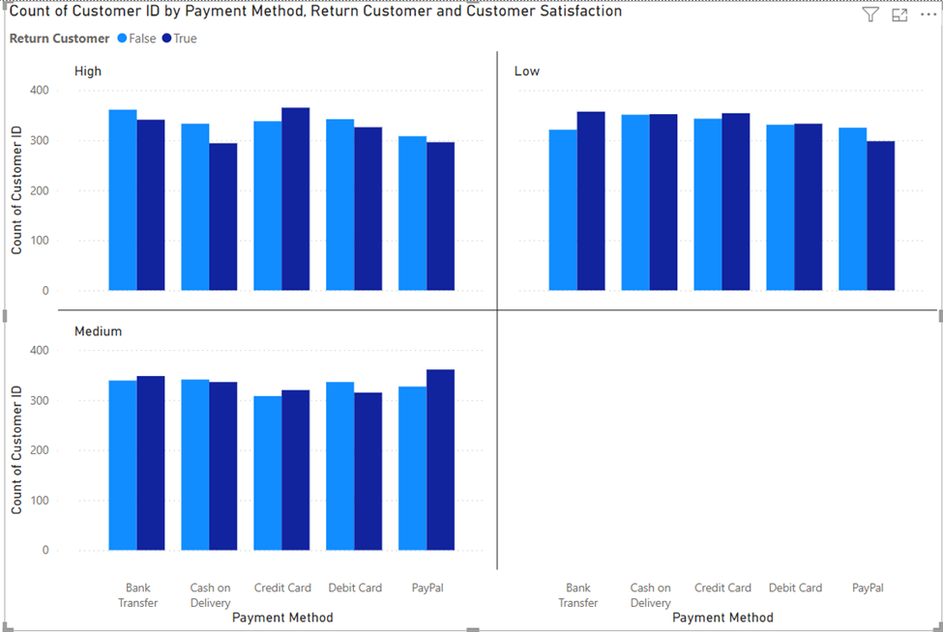
Level 3
Q2: How do payment methods influence customer satisfaction and return rates?
Bank Transfer and Credit Card show the highest customer satisfaction and return rates, with Bank Transfer leading at 50.60% return customers.
Cash on Delivery has the highest medium satisfaction but lower return rates.
Payment methods with higher satisfaction (e.g., Bank Transfer) tend to have higher return rates, highlighting the link between a smooth payment process and customer loyalty.
Recommendations: Improve payment experience for Debit Card and Cash on Delivery users, and leverage high-performing methods in marketing to boost retention.

Slide 23
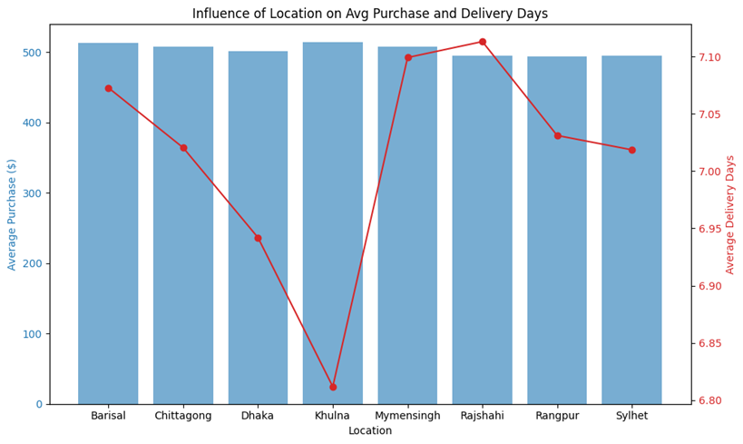
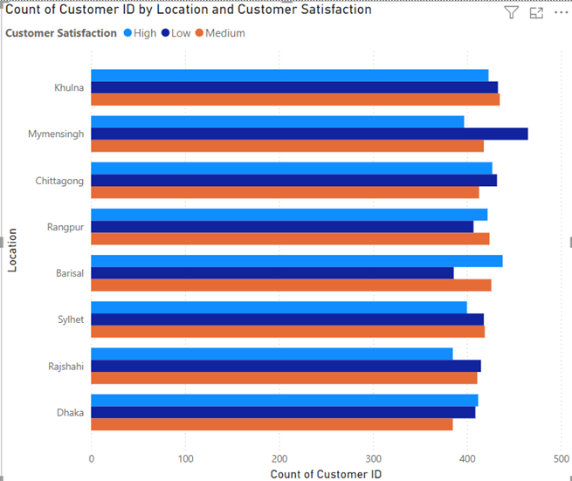
Level 3
Q3: How does the location influence both purchase amount and delivery time?

Slide 24
Level 3
Location Influence on Purchase Amount & Delivery Time
Max Purchases: Sylhet and Dhaka show the highest purchase amounts, indicating affluent customers. Barisal, with the lowest, reflects more budget-conscious shoppers.
Volume: Chittagong leads in purchases, while Rajshahi lags, suggesting different levels of customer engagement.
Average Purchase: Khulna and Barisal have the highest averages, pointing to higher spending per transaction.
Delivery Time: Khulna has the shortest delivery (6.81 days), while Rajshahi experiences the longest (7.11 days), potentially impacting customer satisfaction.
Conclusion: Tailored marketing and improved logistics are needed to boost engagement and satisfaction in lower-performing regions.

Slide 25




Level 3
Q4: What major insights are found? Give a proper explanation.
Customer Loyalty and Return Customers
Influence of Discounts on Return Rates
Minimal Impact of Time Spent on Website
Payment Methods and Customer Satisfaction
49.96%
customers are return customers.
p-value = 0.013
Discounts significantly influence return rates
0.01
Weak correlation between time on site and purchase amount
50.6%
Bank Transfer yields the highest satisfaction and return rates

Slide 26




Level 3
Customer Satisfaction and Review Scores
Demographic Insights
Delivery Time and Subscription Type
Items Purchased and Satisfaction
3.0
Average review score indicating moderate satisfaction.
Age, gender, and location have minimal impact on return rates
7.03 d > 6.96 d
Premium subscribers face slightly longer delivery times than free subscribers.
(-0.003).
Weak negative correlation between items purchased and satisfaction

Slide 27

THANK
YOU

